Slide 1
Review since the midterm:
Asceticism, hatha yoga, tantra and Kashmir Shaivism

Slide 2
Asceticism
In the early traditions, asceticism is usually identified as tapas. It is a heat generating practice that is intended to purify the mind/body complex in order to attain power and/or higher states of consciousness.

Slide 3
Although the ascetics who used these techniques were also associated with the practice of yoga, the physical techniques themselves were not. Early haṭhayoga is a codification of the physical practices of these ascetics.
-- James Mallinson, yoga scholar

Slide 4
The origins of
Hatha Yoga
(900-1000 CE)

Slide 5
Haṭha: to treat violently, to force or oppress
Haṭha yoga: the yoga of forceful exertion

Slide 6
Early Haṭha Yoga
In its earliest formulations, haṭha was used to raise and conserve the physical essence of life, identified in men as bindu (semen), which is otherwise constantly dripping downward from a store in the head and being expended. (The female equivalent, mentioned only occasionally in our sources, is rajas, menstrual fluid.)
--James Mallinson
Brill Encyclopedia of Hinduism

Slide 7
Later Haṭha philosophy:
The emphasis on bindu is replaced with the visualization of kundalini and cakras
This tantric visualization is combined with mudras, physical techniques designed to channel energy in the body

Slide 8
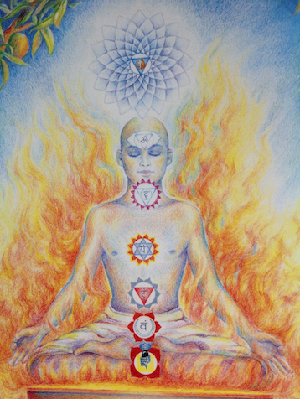

Slide 9
Haṭha yoga represents the yogic body as a sealed hydraulic system within which vital fluids may be channeled upward as they are refined into nectar through the
heat of asceticism.
-- David Gordon White

Slide 10
Haṭhayogapradīpikā
Four chapters:
-asana
-pranayama: breathing techniques
-mudra: physical techniques to channel energy
in the body
the distinguishing characteristic of haṭha yoga prior to the Haṭhayogapradīpikā
-samādhi: a state of “unity” attained through a practice of visualization of subtle energy

Slide 11
Haṭhayogapradīpikā and Yoga Sūtras
4 chapters, sutra style texts
Both texts drew from an existent body of practices to create a codified text.
Both texts became the “classical” texts on yoga for that era.
Both texts combine practices and philosophies that are held separate in other texts.
Both are non-sectarian

Slide 12
Haṭha Yoga and Yoga Sūtras
There is no opposition between Patañjali’s yoga and the techniques in early Haṭha Yoga texts; the practices of Haṭha Yoga are supplementary to those of aṣṭāṅgayoga (eightfold yoga, i.e. Patañjala Yoga).
-James Mallinson

Slide 13
What is the difference between Haṭha Yoga and Rāja Yoga?
In the early texts “Raja Yoga” was equal to Samādhi. It is an ultimate state to be attained and not indicative of a set of practices.
Descriptions of Śāmbhavī Mudrā omit the first 7 limbs of aṣṭāṅgayoga and liken this state to Rājayoga.
The HYP declares that Haṭha and Raja Yogas are interdependent.
Swami Vivekananda (1863-1902) also termed the Yoga of the Yoga Sūtras “Raja Yoga” and suggested that it was primarily “mental practice.”

Slide 14
Profound shifts in envisioning
yoga between 400 & 1000 CE:
Re-framing the goal and primary method of yoga:
Yoga Sutra:
Goal: kaivalya or “aloneness,” disentangling purusha from
its misidentification with prakriti, the material world
Primary method: samadhi or “absorbed concentration”
Hatha yoga:
Goal: union, to realize our identity with the divine
being whose body IS the material world
Primary method: embodied practices such as asana,
pranayama, mudra, mantra, etc.

Slide 15
There is overlap and continuity…
- there were bodily practices in Patanajali’s yoga
- the practices taught in the YS (including samadhi) are included in later yogas
- medieval yogic systems continue to teach their own
version of an eight-fold path
- the Yoga Sutras refer to devotion to the Lord of Yoga
- tantra continues to ground its metaphysics in
the Samkhyan categories (tattvas)

Slide 16
But there is also a profound shift:
- the gods and goddesses and the world that is
their body are inscribed on the human body
- liberation is a process of union that unfolds and is
enacted within the human body
- the human body is the necessary vehicle for liberation
- the senses are the organs for the touch of the absolute
- desire is utilized in service of liberation
- new tattvas are added to the Samkhyan system to reframe the world as nondual in nature

Slide 17
The Yogavasistha:
Composed in Kashmir 800-1250 CE
A nondual text portraying yoga as a practice of self-inquiry

Slide 18
You should be ceaselessly engaged in the pursuit of this gentle inquiry:
Who am I? What is the nature of this universe?
It is this true inquiry alone that generates knowledge.
-- The Yogavasistha

Slide 19
Why waste your life in futile
austerities? Why not reach the
state of the enlightened by
inquiring into the very nature of
human bondage and liberation?
-- the Yogavasistha

Slide 20
The dreamlike nature of
thoughtform is only realized
by the intense practice of yoga.
-- the Yogavasistha

Slide 21
The tantric teachings of
Kashmir Shaivism

Slide 22
Abhinavagupta
950-1025 CE
Kashmir (northern India) author of many texts on philosophy, tantric practice, and aesthetics synthesized all systems into tantra
Abhinavagupta’s student: Kshemaraja
The Heart of Recognition
20 sutras summarizing this worldview written by Kshemaraja ca. 1050 CE

Slide 23
Consciousness, in Her freedom, brings about the attainment of the universe.
-- Pratyabhijnahrdayam, sutra 1

Slide 24
Consciousness herself, having descended from the expanded state, becomes the mind, contracted by the objects of perception.
-- Pratyabhijnahrdayam, sutra 5

Slide 25
That which is full of Consciousness, due to contraction of its powers, becomes a transmigratory soul, covered by impurities.
-- Pratyabhijnahrdayam, sutra 9

Slide 26
When one is fully aware… the mind itself becomes Consciousness by rising to the state of full expansion through inward-facing contemplation.
-- Pratyabhijnahrdayam, sutra 13

Slide 27
The state of liberation while living is the unwavering experience of oneness with Consciousness, even while one perceives the body.
-- Pratyabhijnahrdayam, sutra 16

Slide 28
The yoga of recognition:
recognizing one’s own awareness as the awareness of God
recognizing one’s own identity as Shiva/Shakti
recognizing all that is perceived as one’s own body, the body of God

Slide 29
What is tantra?
A worldview that ultimately spreads throughout Asia…

Slide 30
Tantric practice… aims at ritually gaining access to the energy of the godhead that created and controls the universe, then concentrating and internalizing that power in the body of the devotee. This turns the world and the body into channels of salvation, and a means of merging with the Absolute, but also grants tangible magical powers to the devotee, in this life, in the present.
-- William Dalymple
Notes:
“Lady Twilight”, Nine Lives, p. 207

Slide 31
The empowerment of the body,
which means its divinization,
is the most important quality
in the tantric traditions.
-- Gavin Flood, The Tantric Body

Slide 32
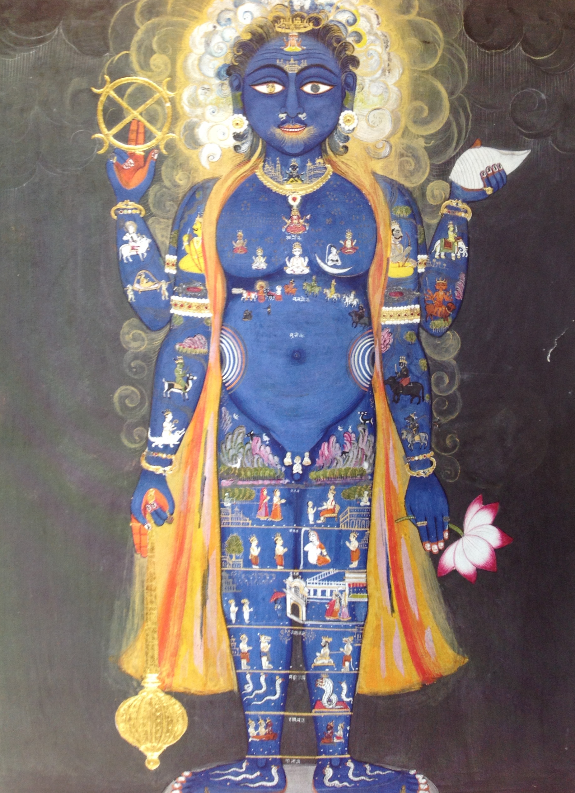
the
tantric
body

Slide 33
Definitions of yoga
in hatha yoga
and Kashmir Shaivism

Slide 34
Gorakṣanātha, the founder of hatha yoga
“Yoga is defined as the unification of the many pairs of opposites,
the unification of in-breath and out-breath,
the unification of the sun and the moon,
the unification of the individual self with the Supreme Self.”
Notes:
Gorakṣanātha’s Yogabīja 89-90

Slide 35
He who sees the entire universe as revolving
inside of himself, who always knows the
universe to be his own self due to his identity
with it… he is a yogi, a knower, a perfected
being, a master.
--Gorakṣanātha

Slide 36
Yoga is the realization
that God and the self
are not different.
Śāradā-tilaka 25.2

Slide 37
The realization of yoga is: identifying one’s awareness with the awareness of God.
-- Abhinavagupta

Slide 38
The ultimate goal of yoga is to
identify one’s own awareness
with the awareness of God.
-- Abhinavagupta

