Slide 1
What is yoga?

Slide 2
June 2013 trial in San Diego:
Can yoga be taught in
elementary schools?
Is yoga religious?

Slide 3

Yoga, the judge said, is similar to other exercise programs, such as dodgeball.
-- The LA Times

Slide 4
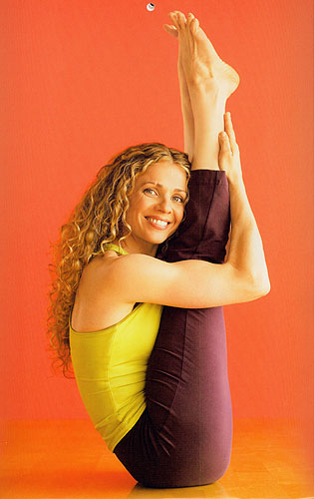
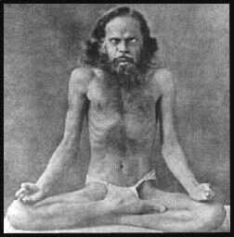

Slide 5
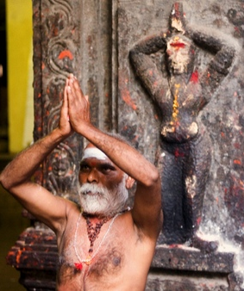
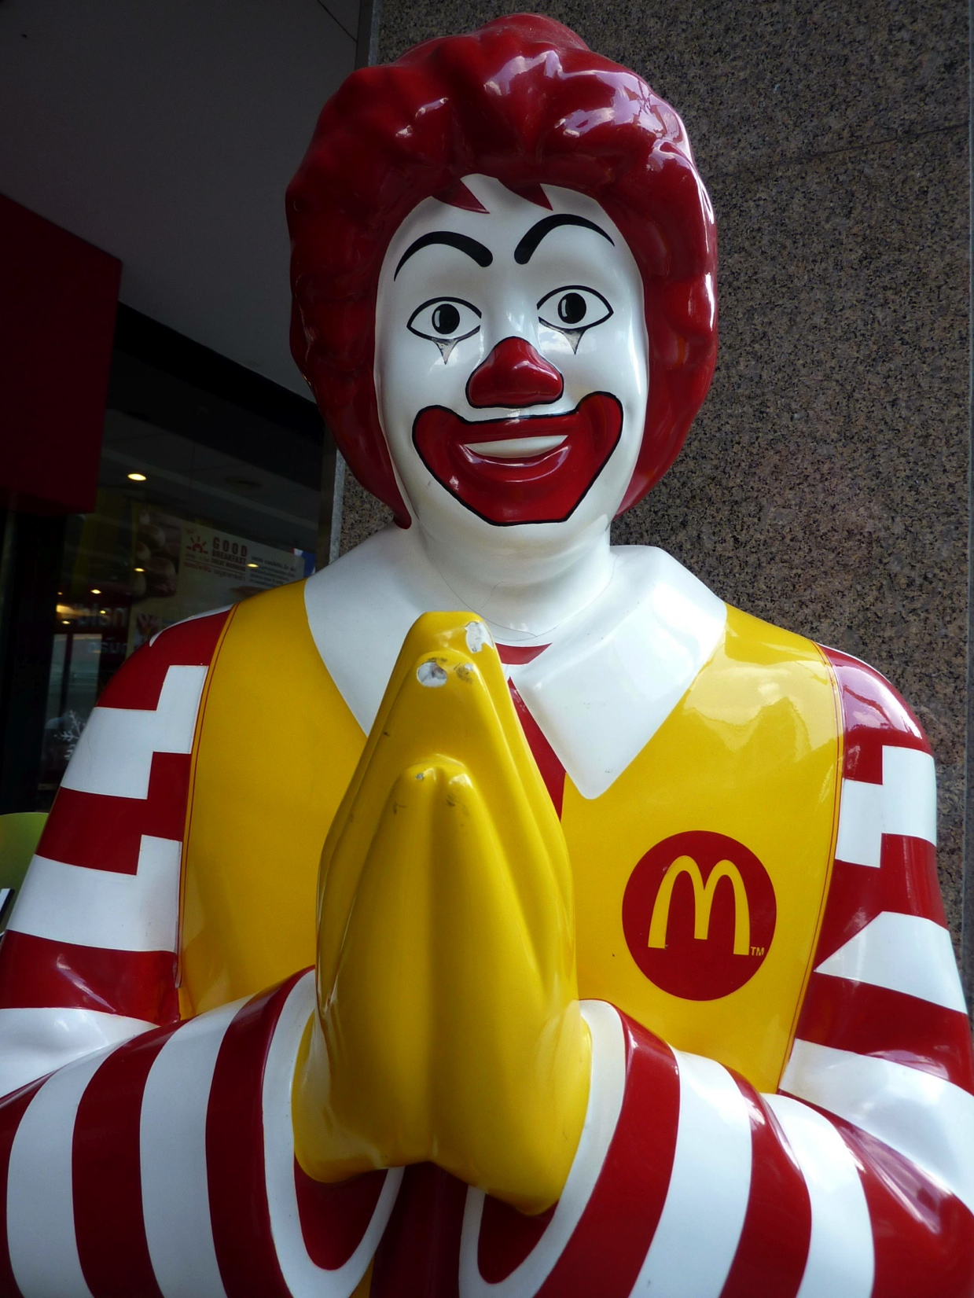

Slide 6


Slide 7
Our goal this semester: to study
the wide variety of ways yoga has
been defined and practiced over
the past 3000 years, in order to
attempt to understand how it has
evolved and changed through time
as it was absorbed into different
cultures and worldviews.

Slide 8
Yoga in the Sanskrit dictionary:
harnessing a horse to a war chariot
mental concentration
strenuous discipline
one of six schools of Indian philosophy
magic trick or spell
union; connection
Notes:
COMPILATION OF ALL USES OF TERM IN SANSKRIT TEXTS

Slide 9
The Vedic hymns used the term “yoga” to refer to the yoking of a warhorse to its chariot, and so yoga as yoking had the extended meaning of “war” or “wartime.”
-- David Gordon White

Slide 10
Violence and constraint have been fundamental to the meaning of the word “yoga” throughout its history.
-- Jean Varenne

Slide 11
Yoga in the
Katha Upanishad
(400-300 BCE)

Slide 12
The Self is hard to percieve,
wrapped in mystery, set in the cave,
and hidden in the depth.
The wise one centers awareness on this Self,
and realizing it as divine,
leaves far behind both joy and sorrow.
Katha Upanishad 2:12-14

Slide 13
Adhyatma-yoga:
the yoga
of centering awareness
on the inner Self

Slide 14
This is what is called yoga:
the steady concentration
of the senses.
Katha Upanishad 6:11

Slide 15
Yoga: harnessing the senses
The body is like a chariot
in which the self rides.
The intelligence is the charioteer,
with the mind as his reins.
As for the horses, those are the senses;
the world is their arena.
Katha Upanishad 3.3

Slide 16
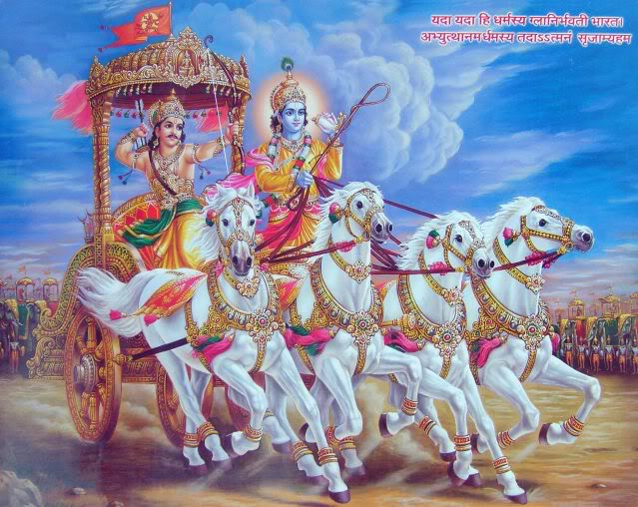
Yoga in the Bhagavad Gita

Slide 17
Three definitions
of yoga
in the Bhagavad Gita

Slide 18
Definitions of yoga in the
Bhagavad Gita
  Yoga is said to be equanimity.
  Yoga is skill in action.
  Let this be known as yoga:
  unbinding the bondage to suffering.

Slide 19
Three paths of yoga in the
Bhagavad Gita
  Karma yoga: the yoga of action
  Jnana yoga: the yoga of knowledge
  Bhakti yoga: the yoga of devotion

Slide 20
Action imprisons the world unless it is done as an offering.
Surrender all actions to me and fix your attention on your inner self.
Relinquishing the fruit of action, the disciplined person attains perfect peace.
-- Bhagavad Gita 3.9, 3.30, 5.12
Karma yoga: the yoga of action

Slide 21
Persistence in knowing the self, this is called knowledge…
The supreme infinite spirit is what is to be known.
-- Lord Krishna, Bhagavad Gita 13.11-12
Jnana yoga: the yoga of knowledge

Slide 22
Fix your mind on Me, worshiping Me, sacrificing to Me, bowing down to Me; in this way you shall come to Me,
I promise, for you are dear to Me.
-- Lord Krishna, Bhagavad Gita 18.65
Bhakti: the yoga of devotion to God

Slide 23
Samkhya and yoga:
Samkhya provides the metaphysical or
theoretical basis for the realization of
purusha, and Yoga offers the technique
or practice itself.
Edwin Bryant, The Yoga Sutras of Patanjali

Slide 24
Samkhya
A dualistic metaphysics,
two fundamental principles:
purusha: “spirit”
prakriti: “matter”

Slide 25
Yoga in the Yoga Sutras
(50-300 CE)

Slide 26
Yoga is the stilling of the
changing states of the mind.
When that happens, the seer
abides in its own true nature.
YS 1:2-3

Slide 27
Ultimate liberation (kaivalya)
is when…the power of
consciousness is situated in
its own true nature.
YS 4:34

Slide 28
Kaivalya literally means the state of
kevala, or aloneness, onlyness, one’s-
own-ness, not-connected-with-
anything-elseness. In other words,
purusha’s awareness is now absorbed
exclusively in its own nature.
Edwin Bryant, The Yoga Sutras of Patanjali

Slide 29
Posture (asana) should be
steady and comfortable. (Such posture should be attained) by the relaxation of effort and the
absorption in the infinite.
YS 2:46-47

